Slide 1
Comparative Analysis of Autoencoder Models
Image Reconstruction: CIFAR-10
Project Code: AI P4
Mentor: Varun
Co-Mentor: B Harish
Institution: ExcelR
Date: 22 Nov 2024
Presented by Group2:
Nikhil Hosamani
Rajesh Pabbati
Sagar Sudhakar Kapse

Slide 2
AGENDA
Business objective
Dataset: CIFAR-10
EDA & Dataset Preparation
Model Implementation & Fine-Tuning
Model Evaluation & Comparative Analysis
Key Observations
Conclusion

Slide 3
1. BUSINESS OBJECTIVE
Conduct a comparative analysis of different of autoencoders such as vanilla autoencoder, convolutional autoencoder and variational autoencoder on a task Image Reconstruction using CIFAR-10 dataset
The goal is to assess each autoencoder type’s performance and efficiency to identify the best model for your specific application
Vanilla autoencoder uses fully connected layers
Convolutional autoencoder uses convolutional layers
Variational autoencoder uses both

Slide 4
2. DATASET: CIFAR-10
Dataset contains 60k rows
10 labels

Slide 5
3. EDA & DATASET PREPARATION
Applied normalization by converting pixel value between 0 and 1
Divided dataset into training 50k and testing 10k
Visualized using plot_sample_images() user defined function
Has 10 different types of labels

Slide 6
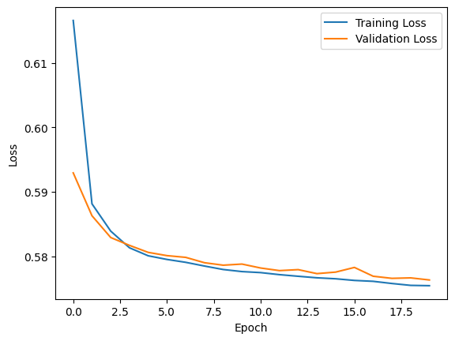
4. Model Implementation & Fine-Tuning
Vanilla Autoencoder
loss: 0.5752 - val_loss: 0.5763

Slide 7
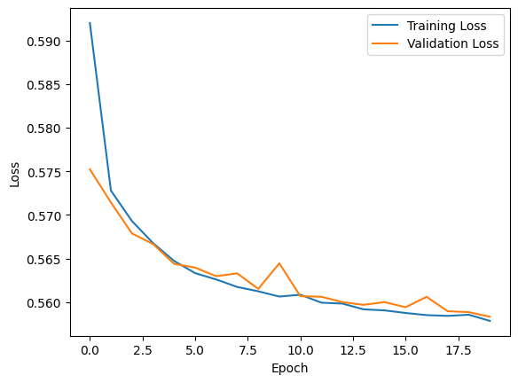
4. Model Implementation & Fine-Tuning
Convolutional Autoencoder
loss: 0.5576 - val_loss: 0.5583

Slide 8
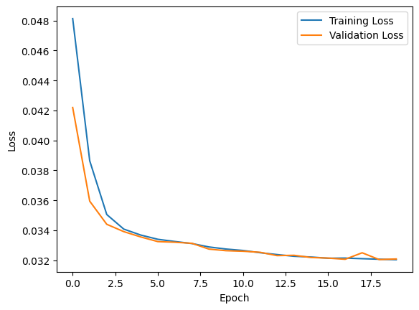
4. Model Implementation & Fine-Tuning
Variational Autoencoder
loss: 0.0319 - val_loss: 0.0321

Slide 9
5. Model Evaluation & Comparative Analysis
Metric | Vanilla Autoencoder | Convolutional Autoencoder | Variational Autoencoder
Reconstruction Loss (Binary Crossentropy) | 0.576312 | 0.558341 | 0.0321149
Mean Squared Error (MSE) | 0.0111522 | 0.00412254 | 0.0242334
Average Inference Time per Image (s) | 0.00359317 | 0.0064838 | 0.0131369
Peak Memory Usage (MB) | 1.35747 | 1.42387 | 1.35711

Slide 10
6. Key Observations
Reconstruction Loss:
The Variational Autoencoder (VAE) achieves the lowest reconstruction loss (0.0321), demonstrating superior quality in reconstructing the images.
Mean Squared Error (MSE):
The Convolutional Autoencoder achieves the best MSE (0.0041), making it the most accurate for pixel-level reconstruction.
Inference Time:
The Vanilla Autoencoder is the fastest (0.0036 s per image), making it ideal for real-time applications where speed is crucial.
Memory Usage:
The Vanilla Autoencoder and Variational Autoencoder both utilize minimal memory (~1.36 MB), outperforming the Convolutional Autoencoder slightly.

Slide 11
7. Conclusion
If reconstruction quality is a priority, the Variational Autoencoder excels despite being slightly slower.
For pixel-level precision, the Convolutional Autoencoder performs best but at the cost of higher memory usage and longer inference time.
If efficiency is key, the Vanilla Autoencoder is the best option due to its minimal inference time and memory usage.

Slide 12
Thank You

